Slide 1
Wav2Vec+DNN+CTC Model
Louis Chuo & Henry An

Slide 2
Model Overview
Based on a pre-trained wav2vec 2.0 model
Combined with two DNN layers
Fine-tuned to Mozilla Common Voice
Final acoustic representation is given to CTC decoder
DNN neurons size: 1024
DNN Type: Leaky ReLU

Slide 3
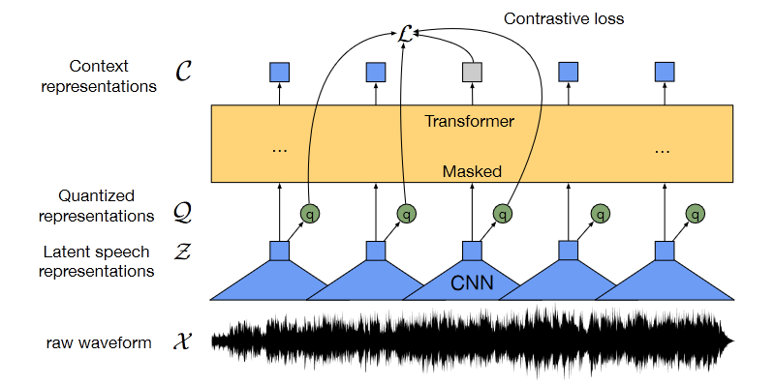
Wav2Vec
Multi-layer convolutional feature encoder
Imported model is Wav2Vec 2.0 Large
Trained on Libri-Light
CNN outputs latent speech representations
Fed into a transformer for building representations on an entire sequence

